Slide 1
PIM Master™ – MW82119B Passive Intermodulation (PIM) Analyzer with Site Master™ Cable & Antenna Analyzer Option

Slide 2
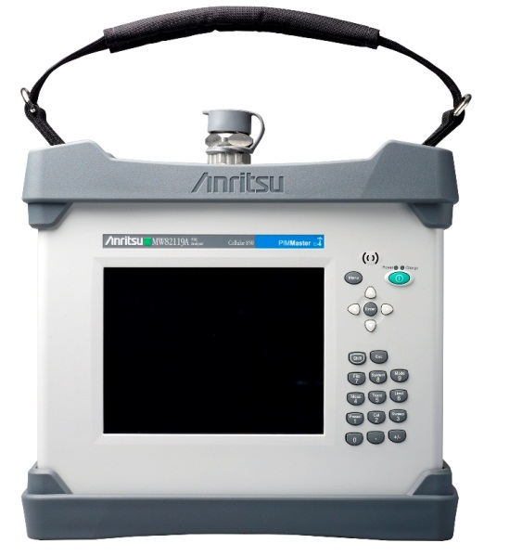
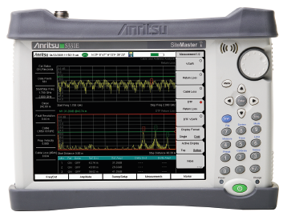
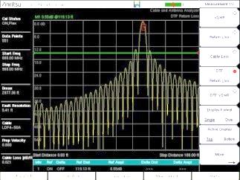
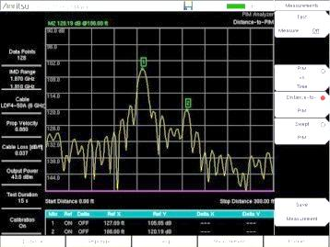
MW82119B – New 3rd Generation PIM Master™
+
=
NEW
MW82119B PIM Master™ with Option 331
MW82119A
PIM Master™
S331E
Site Master™
Integrated Test Solution
One instrument certifies both PIM and Sweep performance
Fewer transit cases to carry to the site
Fewer instruments to hoist to the top of tower
Both test capabilities available when you need them

Slide 3
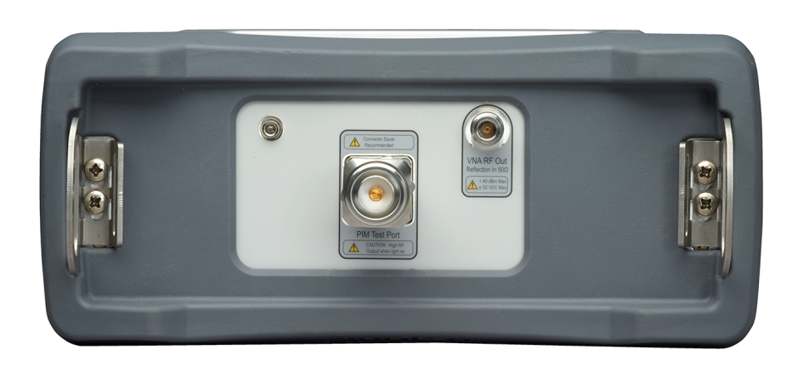
MW82119B – Features
Site Master test port: Type-N (Option 331)
PIM Analyzer test port: 7-16 DIN
Designed with separate test ports to maximize sweep test performance
Highest accuracy
Widest sweep bandwidth

Slide 4
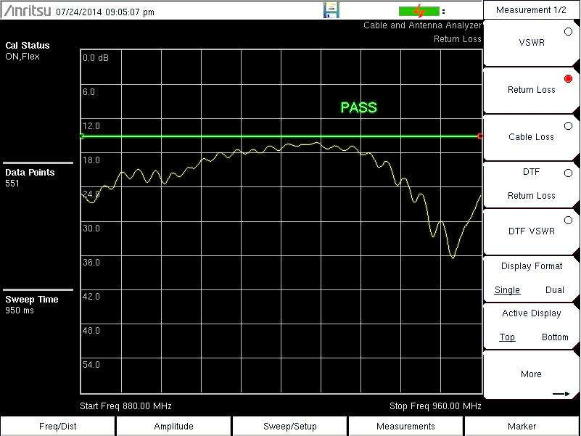
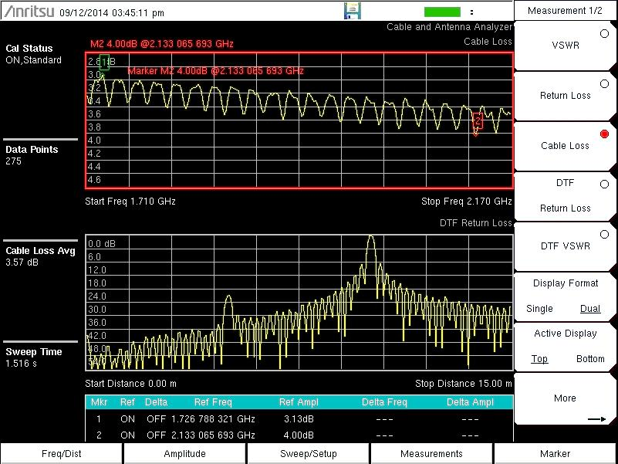
Site Master™ Cable & Antenna Analyzer (Option 331)
Measurements
Return Loss, VSWR,
Cable Loss
Distance-to-Fault (DTF)
1-port Phase
Smith Chart
Performance expected from a Site Master™
2 MHz to 3 GHz
>42 dB directivity
-4 dBm output power
Interference immunity
Features expected from a Site Master™
Dual screen display
Quick-name matrix
Flex Cal

Slide 5
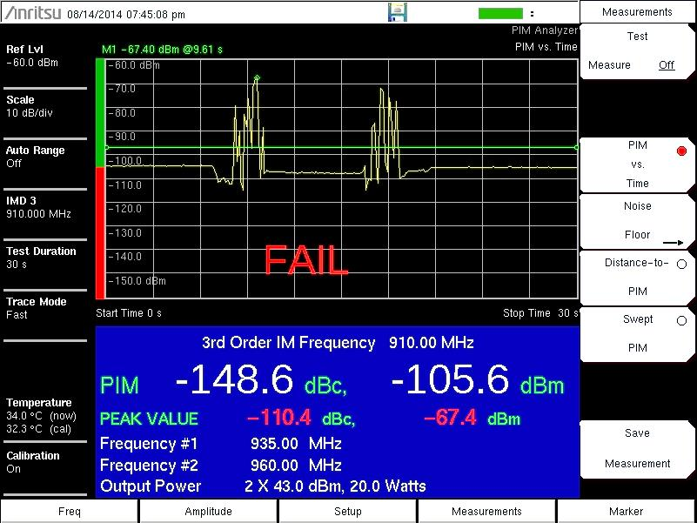
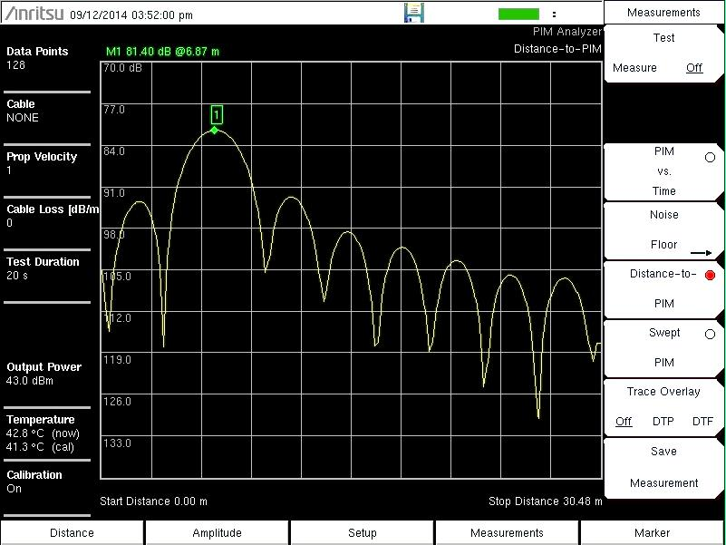
PIM Master™ Passive Intermodulation (PIM) Analyzer
Measurements
PIM vs. Time
Swept PIM
Distance-to-PIM (DTP)
Noise Floor
Frequency Options
MW82119B-0700 – LTE 700 MHz (Upper & Lower)
MW82119B-0702 – APT 700 MHz
MW82119B-0800 – LTE 800 MHz
MW82119B-0850 – Cellular 850 MHz
MW82119B-0900 – E-GSM 900 MHz
MW82119B-0180 – DCS 1800 MHz
MW82119B-0194 – PCS/AWS 1900/2100 MHz
MW82119B-0210 – UMTS 2100 MHz
MW82119B-0260 – LTE 2600 MHz
Test power - 20 dBm (0.1 W) to 46 dBm (40 W)
NEW
NEW
NEW

Slide 6
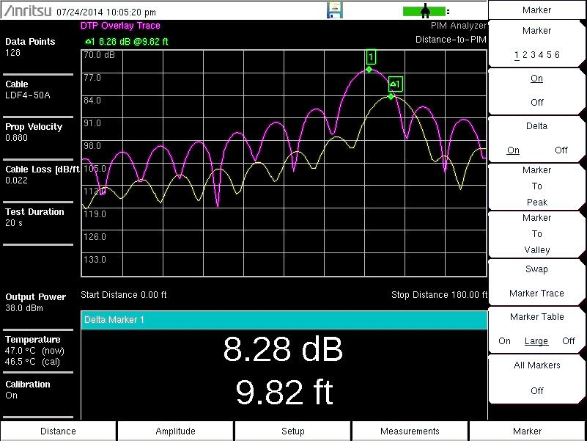
DTP / DTP Trace Overlay (existing capability)
PIM marker DTP trace
Active DTP trace
Distance between PIM marker & unknown PIM source
DTP / DTP overlay is an unique Anritsu PIM Master capability
Use to identify PIM beyond the antenna
Use to show “before” vs. “after” results

Slide 7
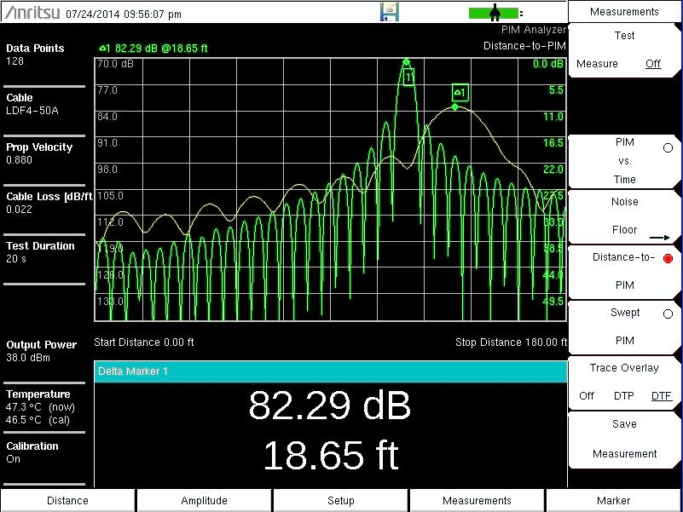
DTP / DTF Trace Overlay
NEW
Cable end
DTF trace
Active DTP trace
Use higher resolution DTF measurements (Option 331) to help locate PIM
DTF into short clearly marks the end of feed cable
Here, the PIM is likely beyond the antenna

Slide 8
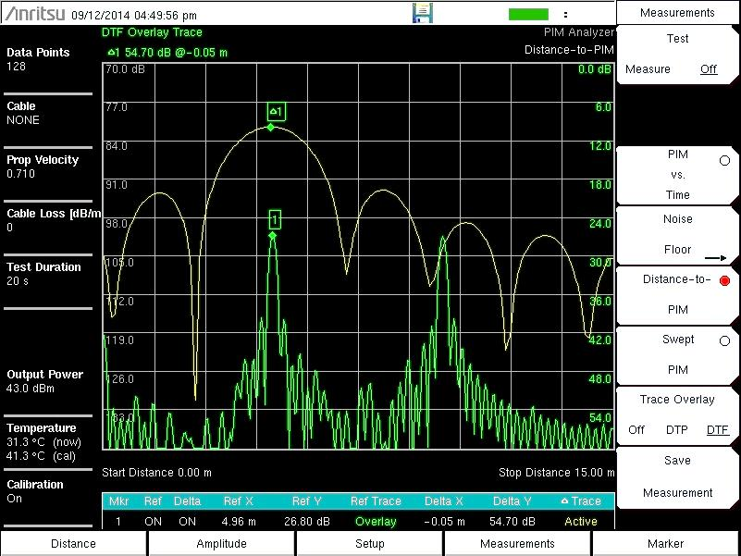
DTF / DTP Trace Overlay
Connector
Connector
Connector
Active DTP trace
DTF trace
DTF into precision load marks connector locations
Here, largest PIM is obviously at 2nd RF connection

Slide 9
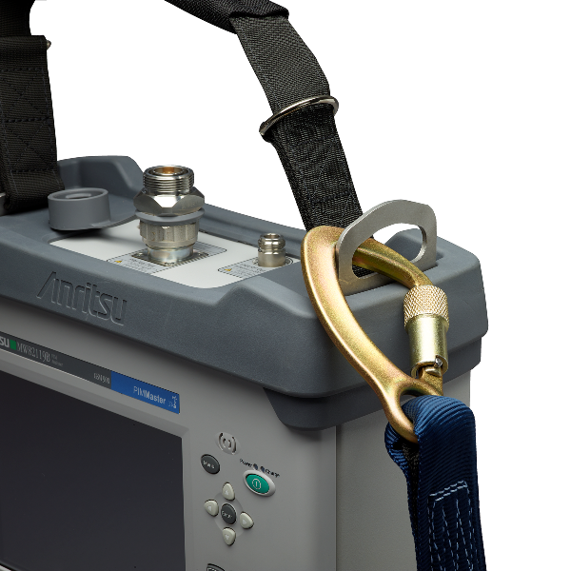
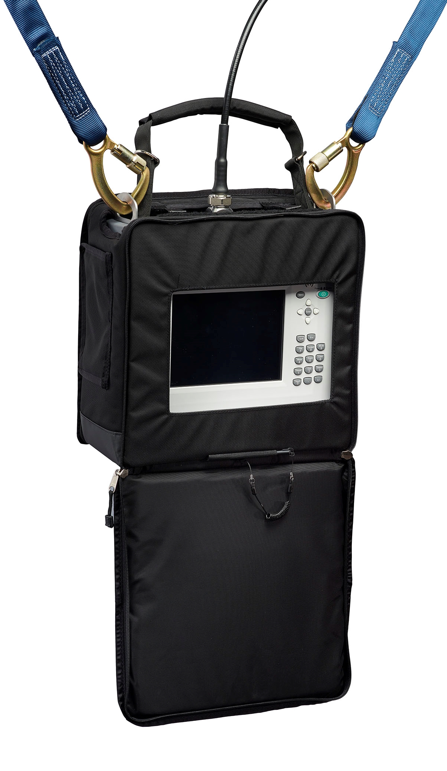
MW82119B – New features
Steel lifting rings for easy rigging
Access to screen & lifting rings in soft case
Stylus
(control wearing gloves)

Slide 10
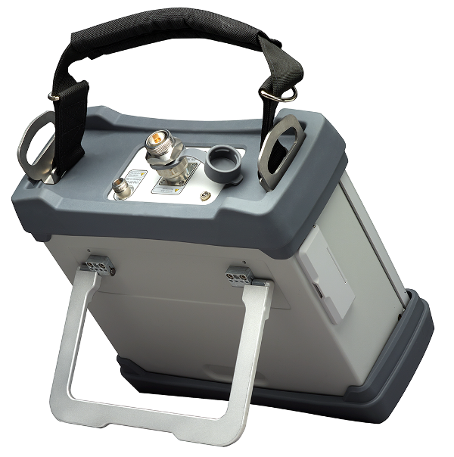
MW82119B – New features
Stronger tilt bail

Slide 11
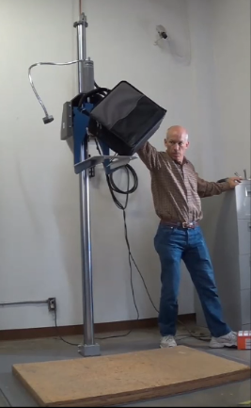
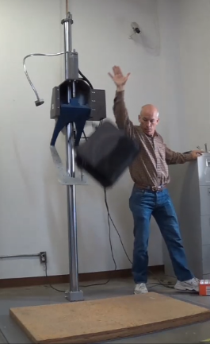
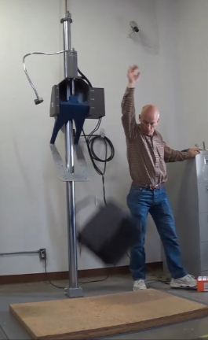
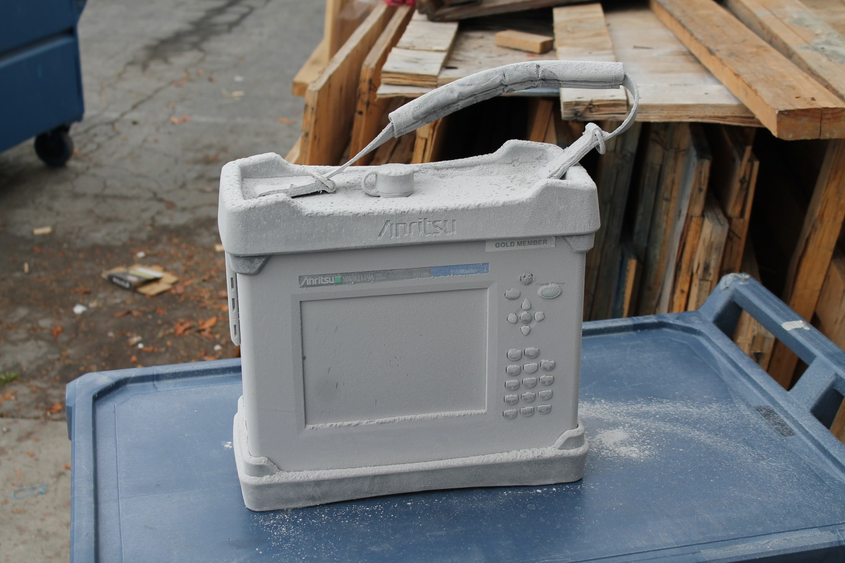
MW82119B – New Environmental tests
MIL-STD-810G
Transit Drop Test
48 in (1.2m) drop height
Each edge, corner, face
26 drops total
IP54 rating
Blowing dust
Water spray

Slide 12
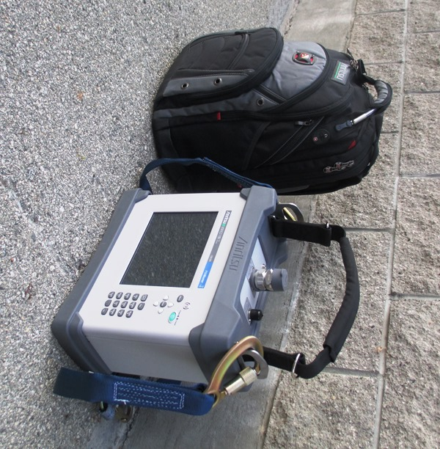
Questions?

